Slide 1
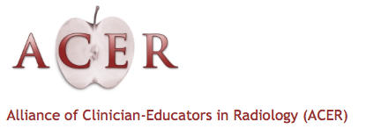
The Radiology Job Market: Current State And Future Trends
Radiology
Medical Student Expo
Alliance of Medical Student Educators In Radiology
Bibb Allen, MD FACR
Chair ACR Board Of Chancellors
April 2, 2016

Slide 2
Photo From The "MythBusters: Jamie and Adam Unleashed" tour

Slide 3
I keep hearing I shouldn’t go into radiology because there won’t be any jobs in radiology when I finish
Myth Or Reality?
Photo From The "MythBusters: Jamie and Adam Unleashed" tour)

Slide 4
Results Of The ACR Workforce Surveys
Radiologists Represented

Slide 5
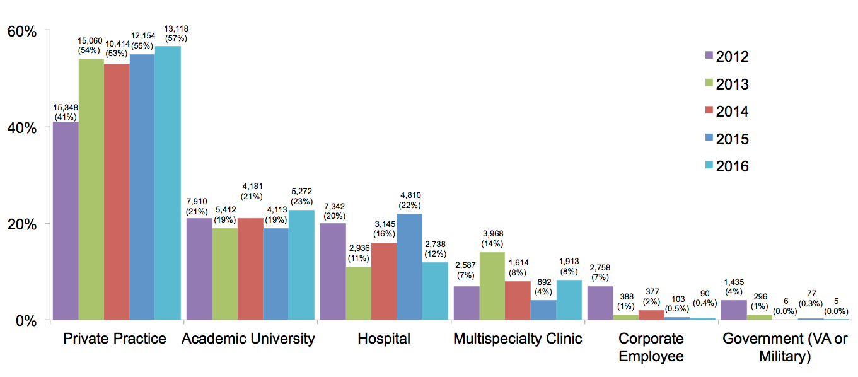
What Are Our Practice Types?

Slide 6
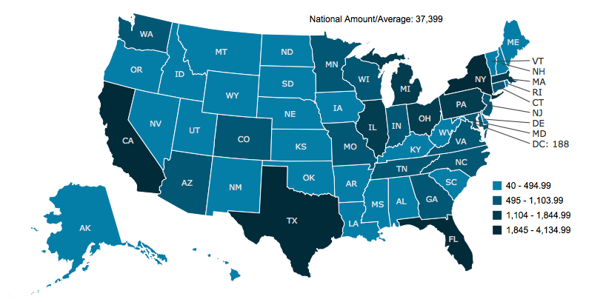
Where Do We Practice?

Slide 7
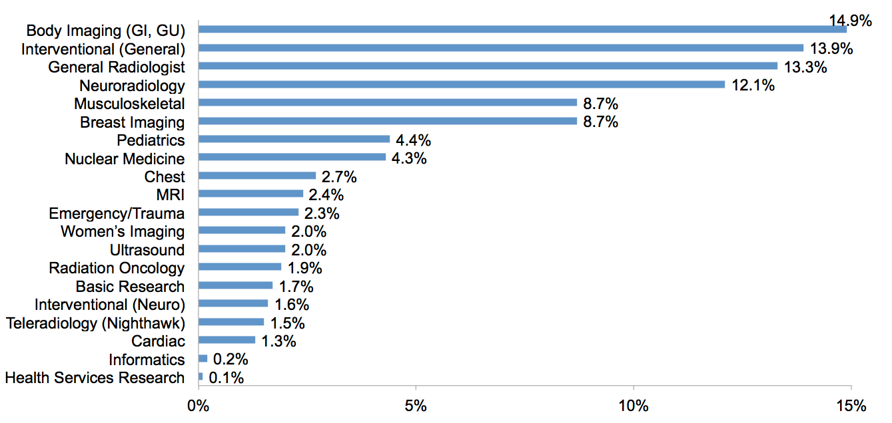
What Are Our Subspecialties?
Most of us are subspecialized in a particular area of radiology

Slide 8
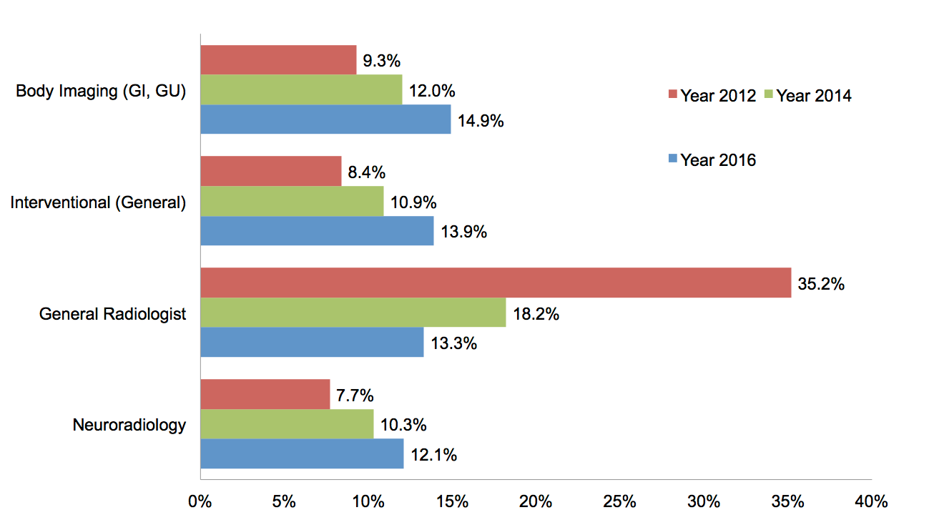
What Are Our Subspecialties?
Trend toward subspecialization is increasing

Slide 9
Percentage Of Time Spent By Fellowship-Trained Radiologists In Their Area Of Expertise
However, our daily practice remains diverse

Slide 10
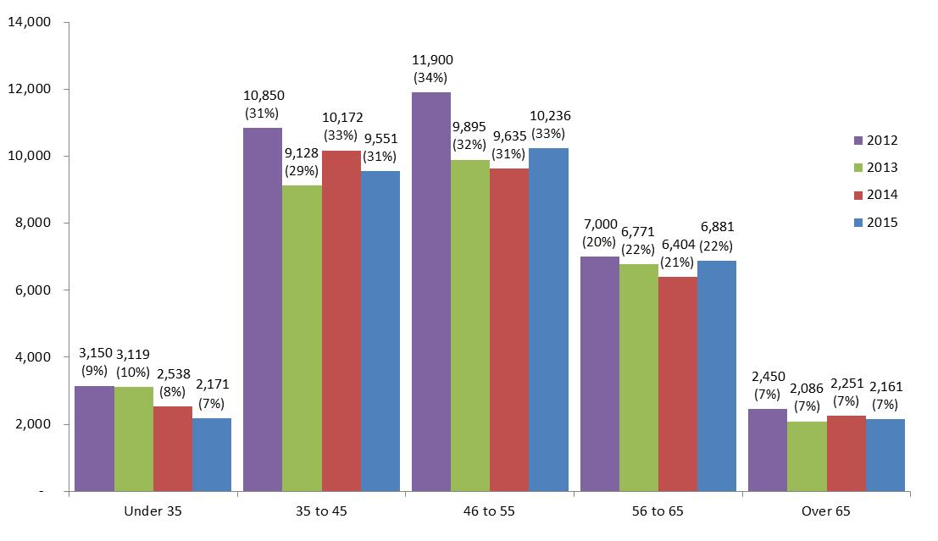
How Old Are We?
Almost 30% of us are over 55 and 7% are over 65

Slide 11
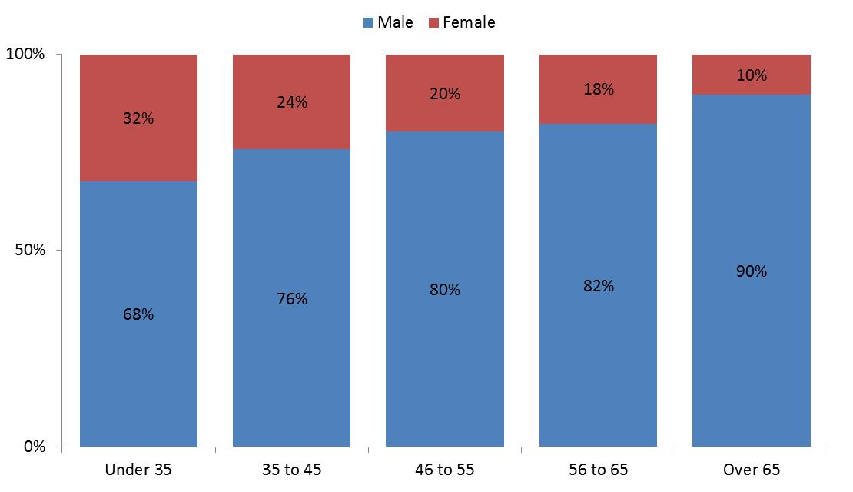
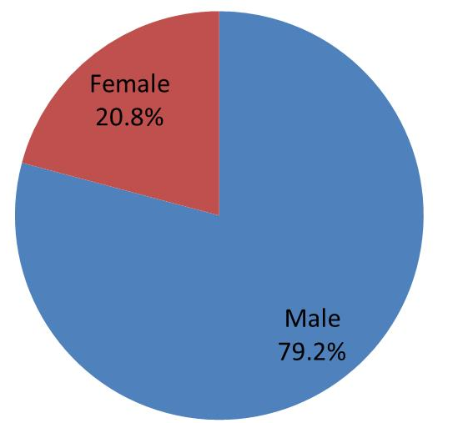
Women In Radiology
Increasing numbers of women are choosing radiology
Compensation and promotion of women in
radiology is higher than almost all other specialties
Anupim Jena, 2015

Slide 12
Hiring Trends For Radiologists - 2015
 | “Plan” to hire in 2014 | Hired in 2014 | Change
Interventional (General) | 134 | 203 | ↑↑
General Radiologist | 111 | 187 | ↑↑
Neuroradiology | 111 | 168 | ↑↑
Body Imaging (GI, GU) | 89 | 156 | ↑↑
Musculoskeletal | 94 | 154 | ↑↑
Breast Imaging | 151 | 123 | ↓
Teleradiology (Nighthawk) | 51 | 72 | ↑
Pediatrics | 71 | 47 | ↓
Nuclear Medicine | 23 | 46 | ↑
Chest | 57 | 44 | ↓
MRI | 23 | 36 | ↑
Women’s Imaging | 37 | 28 | ↓
Emergency/Trauma | 34 | 26 | ↓
Cardiac | 11 | 23 | ↑
Basic Research | 14 | 21 | ↑
Interventional (Neuro) | 17 | 21 | ↑
Ultrasound | 11 | 18 | ↑
Radiation Oncology | 37 | 15 | ↓↓
Informatics | 34 | 5 | ↓
Health Services Research | 0 | 0 | ↔
Projected Total | 1,114 | 1,393

Slide 13
Hiring Trends For Radiologists - 2016
 | Plan to hire in 2015 | Hired in 2015 | Change
Interventional (General) | 187 | 251 | ↑↑
Breast Imaging | 176 | 231 | ↑↑
Body Imaging (GI, GU) | 153 | 215 | ↑↑
Neuroradiology | 144 | 195 | ↑↑
Musculoskeletal | 114 | 167 | ↑↑
General Radiologist | 92 | 162 | ↑↑
Pediatrics | 67 | 77 | ↑
Emergency/Trauma | 100 | 69 | ↓↓
Nuclear Medicine | 30 | 51 | ↑
Chest | 64 | 46 | ↓
Radiation Oncology | 53 | 44 | ↓
Women’s Imaging | 39 | 44 | ↑
Teleradiology (Nighthawk) | 14 | 38 | ↑
Basic Research | 16 | 31 | ↑
Interventional (Neuro) | 23 | 26 | ↑
MRI | 28 | 23 | ↓
Cardiac | 14 | 18 | ↑
Ultrasound | 3 | 10 | ↑
Informatics | 3 | 10 | ↑
Health Services Research | 3 | 0 | ↓
Projected Total | 1,323 (1,131 - 1,484) | 1,707 (1,474 - 1,913)

Slide 14
Range of 2016 Projected Hiring By Subspecialty
The range was calculated using estimated counts of 28,821 to 37,399 radiologists in the country. This estimate was obtained from Harvey L Neiman Health Policy Institute.

Slide 15
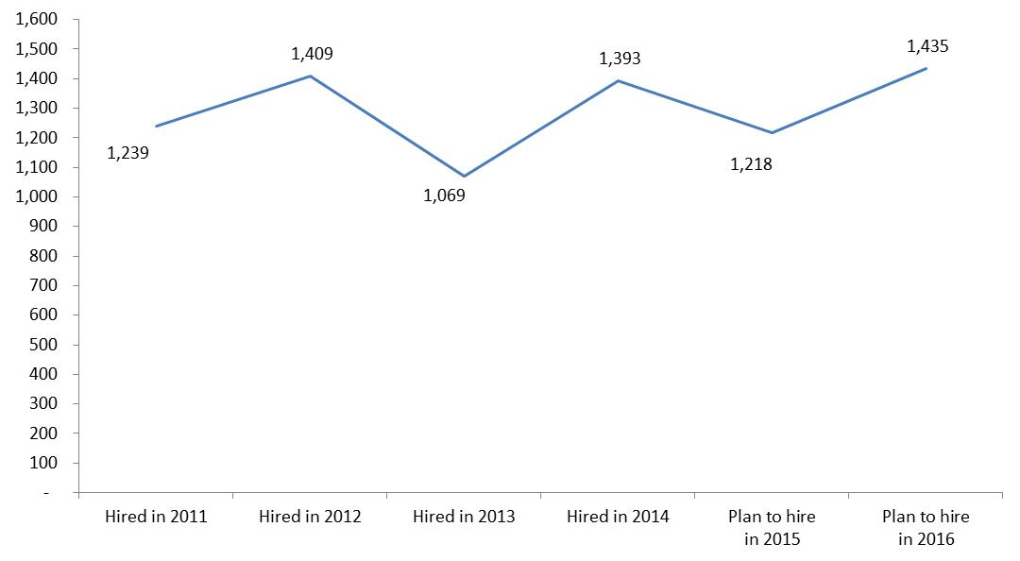
Hiring/Projection Trends 2011 To 2016
Available positions in academic radiology have returned to 2009 levels
Survey of academic chairs, D. Maynard MD

Slide 16
A Look To The Future

Slide 17
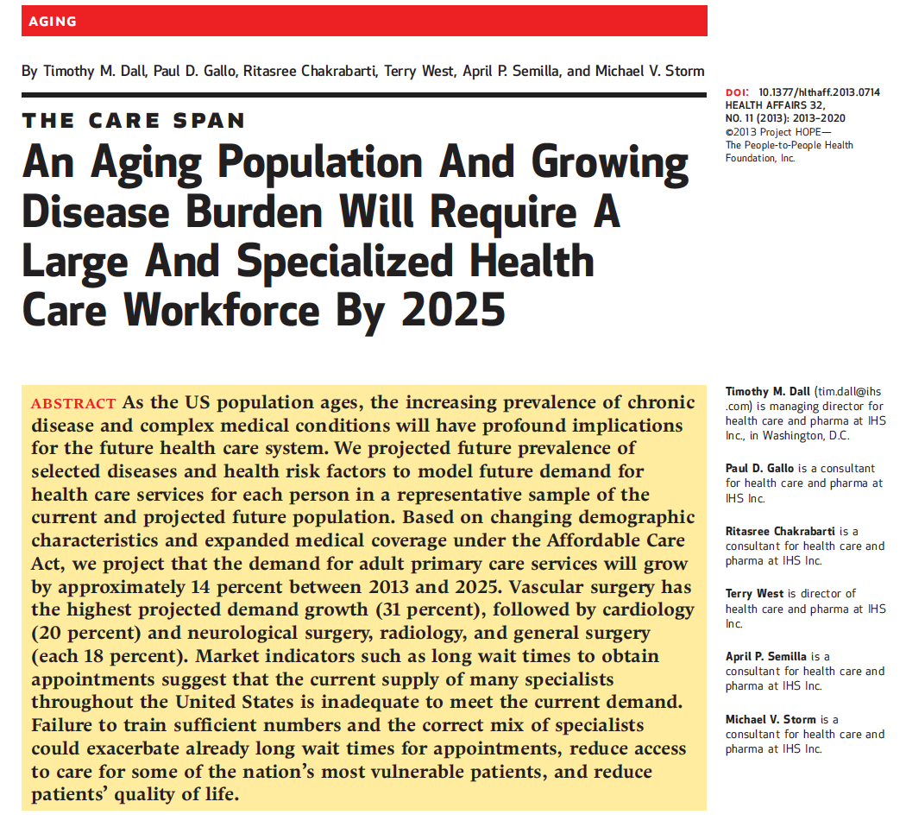
A Look To The Future
Future Demands For Physicians
Vascular surgery
Cardiology
Radiology
General surgery

Slide 18
Radiologists’ Increasing Role In Population Health Management
Inappropriate Imaging Requested
Inappropriate care and risk
Over-diagnosis
Increased cost
Radiologist consultations
Patients
Imaging Not Requested
Appropriate – lowers cost
What if imaging should have been requested?
Under-diagnosis
Poor health outcomes
Higher cost
Decision support

Slide 19
Radiologists’ Role In Population Health
Electronic Heath Records
Radiologists Play An Increasing Role In Guiding The Diagnostic Workup
All Of The Care That Is Necessary And None That Is Not

Slide 20
Radiologists’ Role In Population Health
Radiologists Will Play Important Roles In reducing Variability In Medical Care

Slide 21
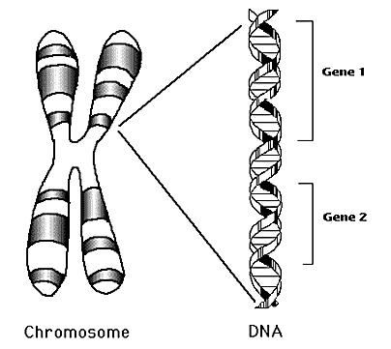
Radiologists’ Role In Population Health
The Medicine Of Tomorrow
Patients
Precision / Personalized Medicine
Customization or “personalization” of care based on a patient’s genotype and phenotype and the genotype and phenotype of a patient’s disease e.g. cancer
Focus shifts from knowledge of populations to personalized knowledge of individual patients
James Thrall, MD - ACR Moreton Lecture May 2015

Slide 22
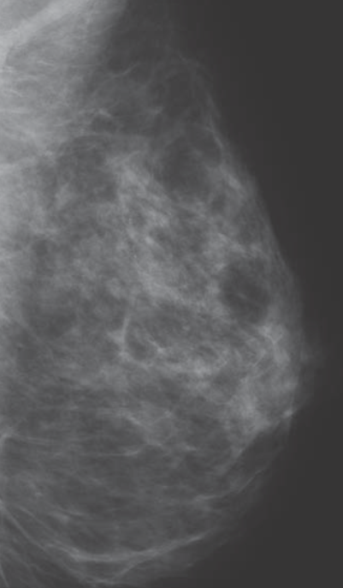
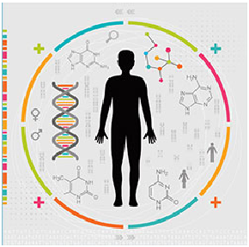
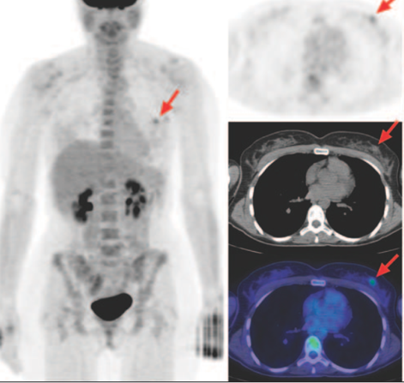
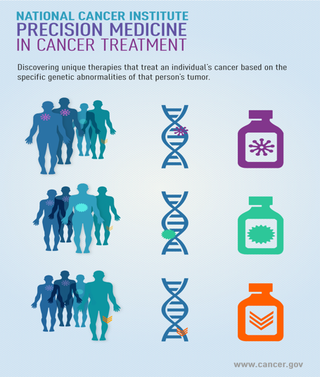
Radiologists’ Role In Population Health
Identification Of A Population Subset At High Risk
Targeted Imaging
Targeted Therapy
Adapted From Sam Gambhir, MD
MGH Hampton Symposium March 2016
http://www.cornellcurrent.com/wp-content/uploads/2015/03/Precision-Medicine.png
www.ajronline.org/doi/pdf/10.2214/AJR.10.7243

Slide 23
Radiologists Are Integral To Team Based Care

Slide 24
Radiologists Are Integral To Team Based Care
Predict 1,900 openings in 2016 - 2017
This is well more than the number of finishing residents / fellows
Trend shows a general increase in hiring from 2013
Available positions in academic practices have returned to 2009 levels
Increasing percentage of our workforce are women and once women enter the workforce they are highly valued based compensational and promotional equity
Demand for radiologists will likely increase
Aging population associated with increase need for radiologists
Workforce needs may change depending on retirement of senior group members
7% (or 2,161) of workforce > 65
22% (or 6,881) of workforce between 56 and 65

Slide 25
I keep hearing I shouldn’t go into radiology because there won’t be any jobs in radiology when I finish
BUSTED!!
Photo From The "MythBusters: Jamie and Adam Unleashed" tour

Slide 26
Many Thanks And Thanks To The ACR Human Resources Commission
ACR Staff:
Jan T. Cox, PHR
Daniel Green
Meghan Deaver
Edward I. Bluth, MD FACR, Chair Elizabeth K. Arleo, MD Claire E. Bender, MD FACR E. Michael Donner III, MD FACR Sharon C. Dutton, MD Michael Francavilla, MD Jay A. Harolds, MD FACR | Robert D. Harris, MD, MPH FACR Andrew Moriarity, MD Jay R. Parikh, MD FACR Robert J. Rapoport, MD FACR Michael P. Recht, MD Gordon K. Sze, MD, FACR Sidney Ulreich, MD FACR

